Slide 1
Topic: Data EQ: How do dot plots represent frequency distribution?
Year 11 Essentials

Slide 2
Five Questions
Topic: Data
Date:
EQ – How do dot plots represent frequency distribution?
Find 30% off $60
Add brackets to make this equation true: 145 – 24 + 17 x 3 = 22
Fill in the missing numbers: 1.35m = ______ mm ______ mL = 3.5L 4.7 kg = _____ g
The average volunteer performed 128 hours of unpaid work during 2014. How many days does this equate to if a normal working day is 8 hours?
Write 18.3 as a fraction
Notes:
$42
145 – (24 + 17) x 3 = 22
1350mm 3500mL 4700g
16 days
18 3/10

Slide 3
24
7
30
Topic: Data
Date:
EQ – How do dot plots represent frequency distribution?
Dot plots are a simple way of representing a data set. They are constructed by putting a dot for each data value above a scale.
To create a dot plot:
Determine the range and construct a number line from the lowest value to the highest value. Leave space above the line for the dots.
Put dots for each number above the scale.
Label your graph with a title and axis labels (units).
What are dot plots?
WICOR
Notes:
Check for understanding!
What is numerical data?
What is categorical data?
What is discrete data?
What makes data continuous?

Slide 4
Interleaved Textbook pg. 107
Flexibility measurements from Yr. 11 class (pg. 106)
Baseline | -5 | -7 | -4 | 2 | 1 | -3 | -3 | -4 | -1 | -3 | -6 | -8 | 3 | -4 | -4 | -2 | -1 | 0 | -5 | -6
4 wks. | -4 | -7 | -3 | 3 | 2 | -3 | -2 | -2 | 0 | -3 | -5 | -6 | 3 | -3 | -4 | -2 | 0 | 1 | -4 | -5
Using the data provided create a set of 2 dot plots – one for each row and leave plenty
of space above the number line.
Compare the two dot plots? What do you notice? How are they similar?
How are they different?

Slide 5
Interleaved Textbook pg. 107
Sketch a box plot from the same data above the each dot plot.
How is each box plot similar to the matching dot plot?
What information is provided in the dot plot that is not provided in the box plot?
What information is provided in the box plot that is not provided in the dot plot?
With your shoulder buddy discuss and write down a situation when you think each graph would be more appropriate. Give reasons for your answers.

Slide 6
Task
Find the mean, median, mode and range from both dot plots. Describe how you find it as your notes. If you need to, check with someone on your table group.

Slide 7
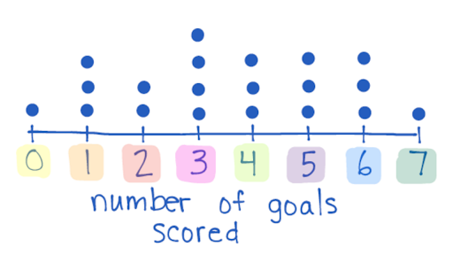
24
7
30
Topic: Data
Date:
EQ – How do dot plots represent frequency distribution?
To find the mean, median and mode from a dot plot, it helps to write out your data set from the graph in ascending order. From the dot plot below, the data set is {0,1,1,1,2,2,3,3,3,3,4,4,4,5,5,5,6,6,6,7}
How do I find the mean, median and mode from dot plots?
WICOR
Notes:
Check for understanding!
What is numerical data?
What is categorical data?
What is discrete data?
What makes data continuous?

Slide 8
24
7
30
Topic: Data
Date:
EQ – How do dot plots represent frequency distribution?
{0,1,1,1,2,2,3,3,3,3,4,4,4,5,5,5,6,6,6,7}
Using the values above, the mean can be calculated by using:
Mean = Sum of all data points
Number of data points
How do I find the mean, median and mode from dot plots?
WICOR
Notes:
Check for understanding!
What is numerical data?
What is categorical data?
What is discrete data?
What makes data continuous?

Slide 9
24
7
30
Topic: Data
Date:
EQ – How do dot plots represent frequency distribution?
{0,1,1,1,2,2,3,3,3,3,4,4,4,5,5,5,6,6,6,7}
The median is the middle number. As we have an even number of values, we add the 2 middle numbers and divide by 2.
Median = 3.5
How do I find the mean, median and mode from dot plots?
WICOR
Notes:
Check for understanding!
What is numerical data?
What is categorical data?
What is discrete data?
What makes data continuous?

Slide 10
24
7
30
Topic: Data
Date:
EQ – How do dot plots represent frequency distribution?
{0,1,1,1,2,2,3,3,3,3,4,4,4,5,5,5,6,6,6,7}
The mode is the number or category with the most dots (the most frequent value). Mode = 3
How do I find the mean, median and mode from dot plots?
WICOR
Notes:
Check for understanding!
What is numerical data?
What is categorical data?
What is discrete data?
What makes data continuous?

Slide 11
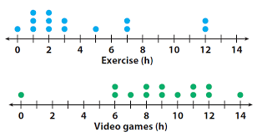
Task
For the dot plots pictured: Find the mean, median, mode and range for Exercise and Video games.

Slide 12
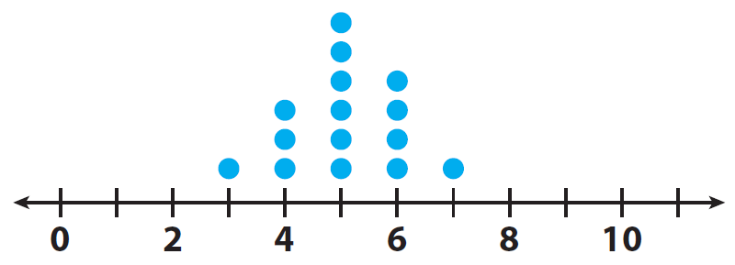
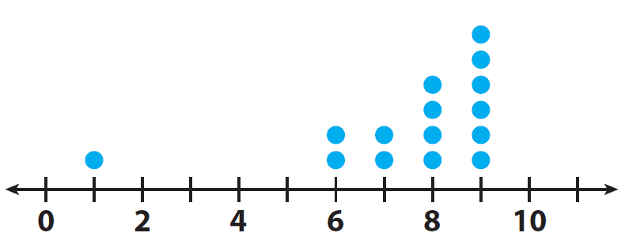
Additional practise
A
Find the mean, median, mode and range for each dot plot and describe the shape of the data (symmetry, skew and outliers).
B

Slide 13
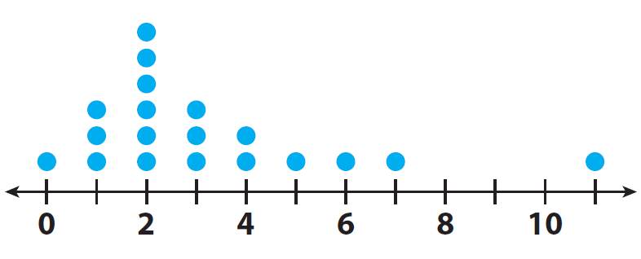
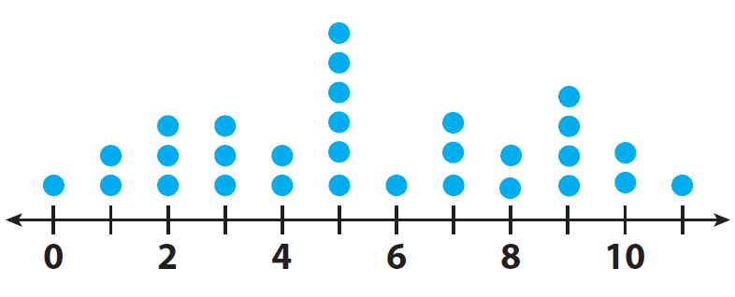
Additional practise
C
Find the mean, median, mode and range for each dot plot and describe the shape of the data (symmetry, skew and outliers).
D

